Slide 1
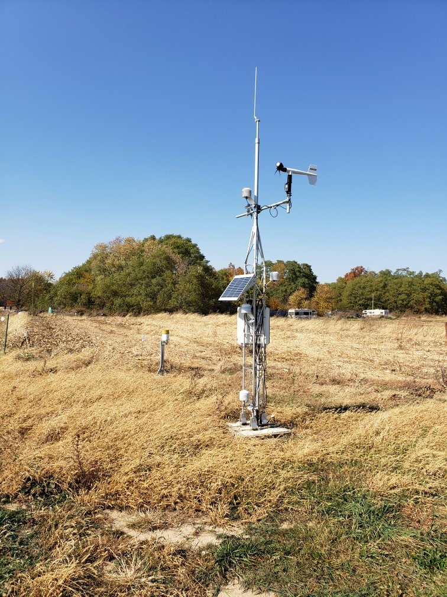
Purdue ISCO and
Indiana Geological & Water Survey
-Indiana Mesonet
IMAB
June 2024

Slide 2
Indiana Mesonet
Mission: Collect and deliver reliable, high-quality, local weather, water, and soil information across Indiana to be used for the public good.
Vision: An accessible weather, water, and soil observational network across Indiana serving all communities, to enhance public safety, improve economic and resource management, and meet evolving needs.
Indiana Mesonet Advisory Board -
IMAB
Purpose:
Advise, promote, and facilitate the expansion of a reliable, high-quality network of weather, water, and soil observational locations across all Indiana counties.

Slide 3

Costs
Up-front weather/soil costs: $40,000 per station
  Materials = $30,000
  Concrete bases = $2,000
  Security fence = ~$3,000
  Installation = $5,000
Ongoing personnel costs: $961,870 per year (13 people)
  Site technicians (1 per 12 stations [8 tot]) - $42,000*8=$336,000
  Database and Application’s Developer (1.5 people) - $120,700*1.5=$181,050
  Site Host Coordinator (50%) - $50,000
  Hydro monitoring manager (50%) - $60,000
  Program Manager (50%) - $60,000
Up-front Water monitoring costs:
  Deep Soil Monitoring ($15,000 per station)
    •Materials = $7,000
    •Installation = $8,000
  •Water Table ($15,000 per station)
    •Materials = $6,000
    •Installation = $9,000
  •Aquifer Monitoring ($40,000 per station)
    •Materials = $3,000
    •Installation = $37,000
  •Runoff Monitoring ($15,000 per station)
    •Materials = $7,500
    •Installation = $7,500
Annual operating costs for 92 stations: $1.5M
  Personnel = $687,050
  Fringe = $274,820
  Sensor replacement = $200,000
  Calibrations = $40,000
  Administrative = $409,000
24 counties currently have stations
68 counties still need station
68 x $135,000 = $9.2M

Slide 4
Funding Planning
Pros & Cons
Mechanisms:
Foundations
IMAB becomes 501 (c)(3)
Line Item to Universities
Line Item to One University and MOU
Pass-through
  DNR-Other state
  IFA
  AWWA
  IWRA
  NGO/Non-Profit, 501 (c)(3)

Slide 5
Supporters of Indiana Mesonet & IMAB
    Funding, marketing, and sustainability
    Technical guidance and value-added tools
    Research and engagement

Slide 6
Formation of Indiana Mesonet & IMAB
Complimentary networks; Remove redundancy; Leverage each other’s specialties and resources
IMAB members
  Federal
    USGS
    NWS
    USDA-NRCS
  State
    IN-DNR
    ISDA
    IDHS
    IDEM
  Agriculture
    Keystone Coop (Co-Alliance)
    Nutrient Alliance
    IN Farm Bureau (???)
  Energy
    MISO Group
  Other
    INTERA
    Retired Community Engager
Who is missing
NGOs – TNC? Ducks Unlimited? Others?
Associations –
  AWWA?
  IN Rural Water Alliance? IN Rural Water Assoc? (Karen Beal? Laurel Johnston)
  Assoc of IN Counties
  Superintendents
  County Commissioners Assoc
  IN Rural Water Assoc
  Association of Energy Suppliers (Jeff Cummins?)
  Indiana American Water (Justin Schneider?)
  Citizens (Dan Moran?)
IFA
Health Sector

Slide 7
Governance of Indiana Mesonet & IMAB
Complimentary networks; Remove redundancy; Leverage each other’s specialties and resources
Shared Services
  Aligned objectives and priorities with organizational goals
  Effective communication
  Collaboration among stakeholders
  Strong Leadership
  Well defined governance structure
Strategy Development
  Key Stakeholders/Board helping to ID objectives
  Alignment with Organizational Goals
  ID scope of services provided
  Prioritize services based on value added
Governance Structure
  Clear Roles outlined
  Leadership Responsibilities clear
  Communications expectations outlined
  Board oversight committee
  Operating Model
    Decisions methodology
    Performance Framework
    Monitoring and Reporting
    Workforce Development
    Partner action plans
  Others?

Slide 8


Two Indiana Monitoring Networks
Extension
State Climate Office
GDDs
Agriculture
Water
Monitoring
Temperature
Climate/Weather Monitoring
Humidity
Winds
Inversions
Ground Water
PET
Precipitation
Solar Radiation
Surface/Groundwater Interactions
Soil T & M
Runoff
Geology
Streamflow

Slide 9
Marketing
What is needed in our 3 slide pitch deck?

Slide 10
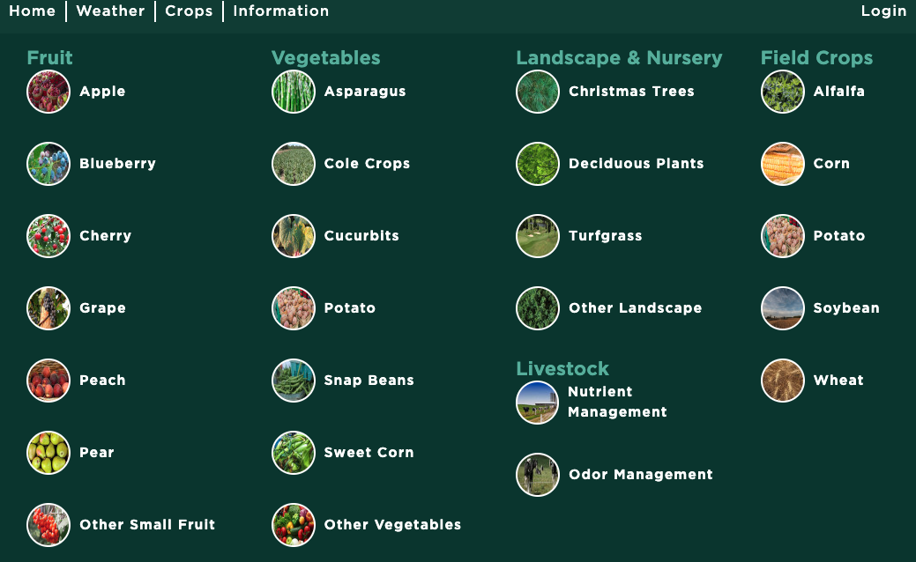
Mesonet Resources Elsewhere

Slide 11
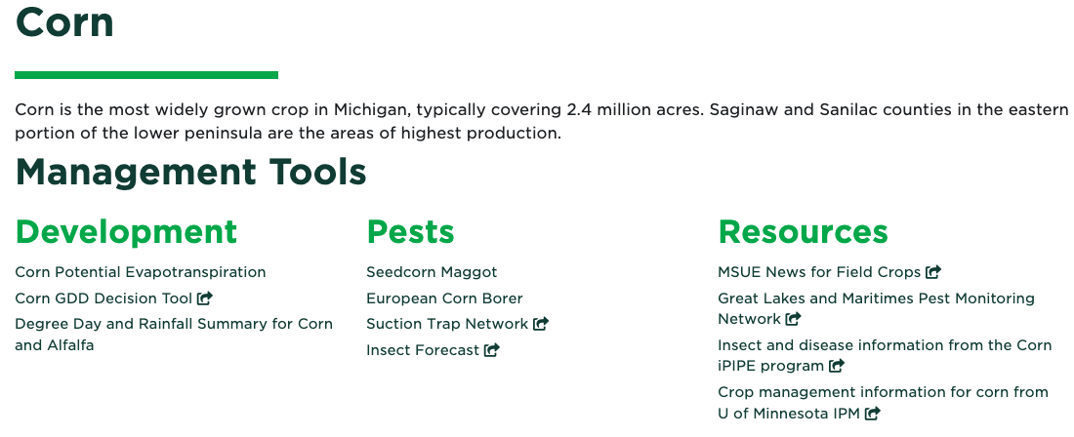
Mesonet Resources Elsewhere

Slide 12
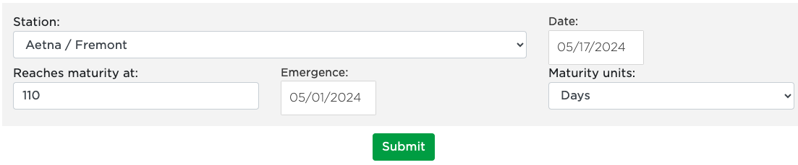
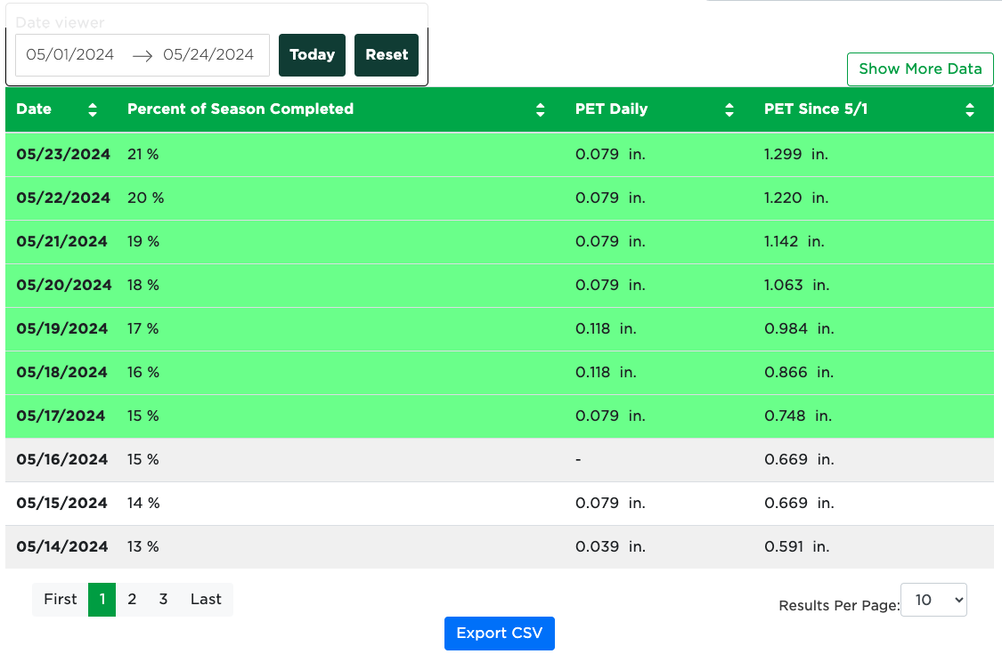
Mesonet Resources Elsewhere

Slide 13
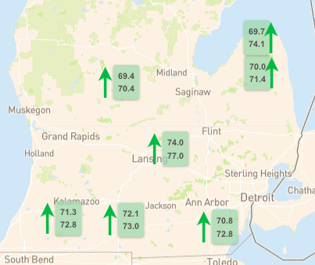

Mesonet Resources Elsewhere

Slide 14
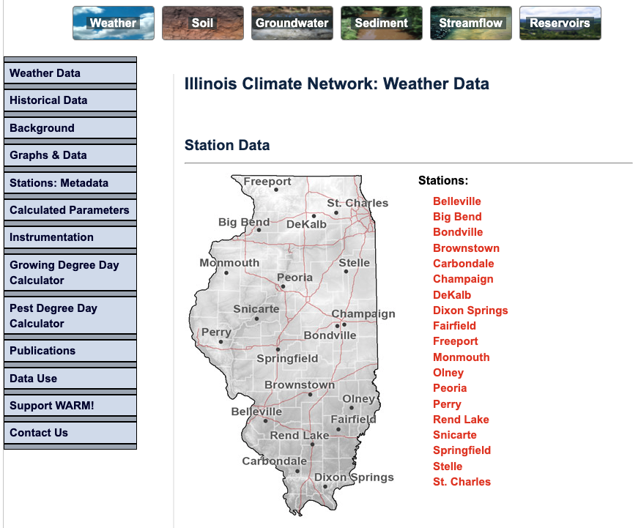
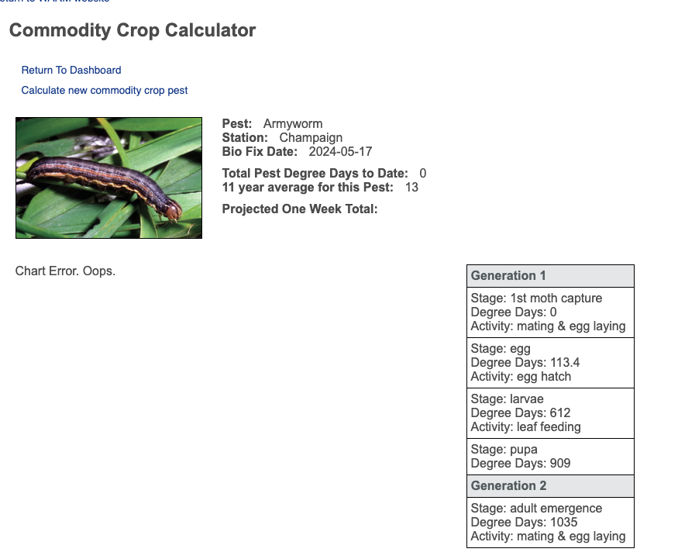
Mesonet Resources Elsewhere

Slide 15

We have a Logo!

Slide 16

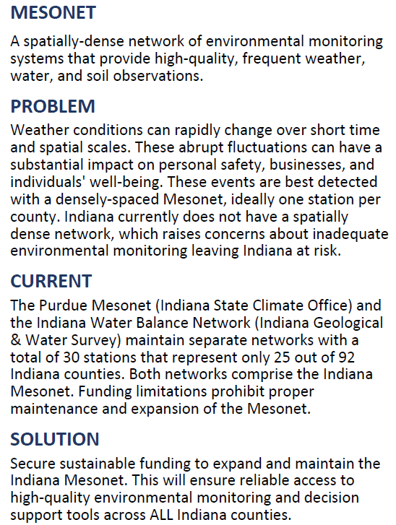
Feedback?

Slide 17
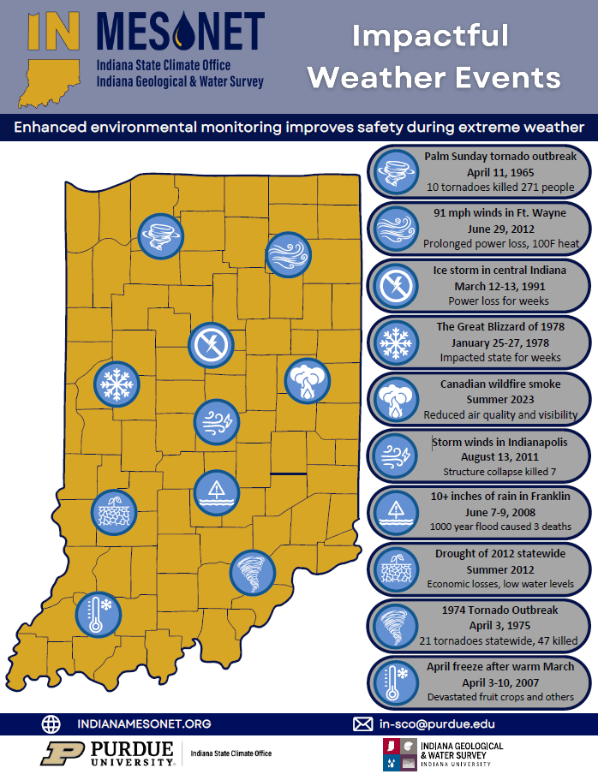
Feedback?

Slide 18
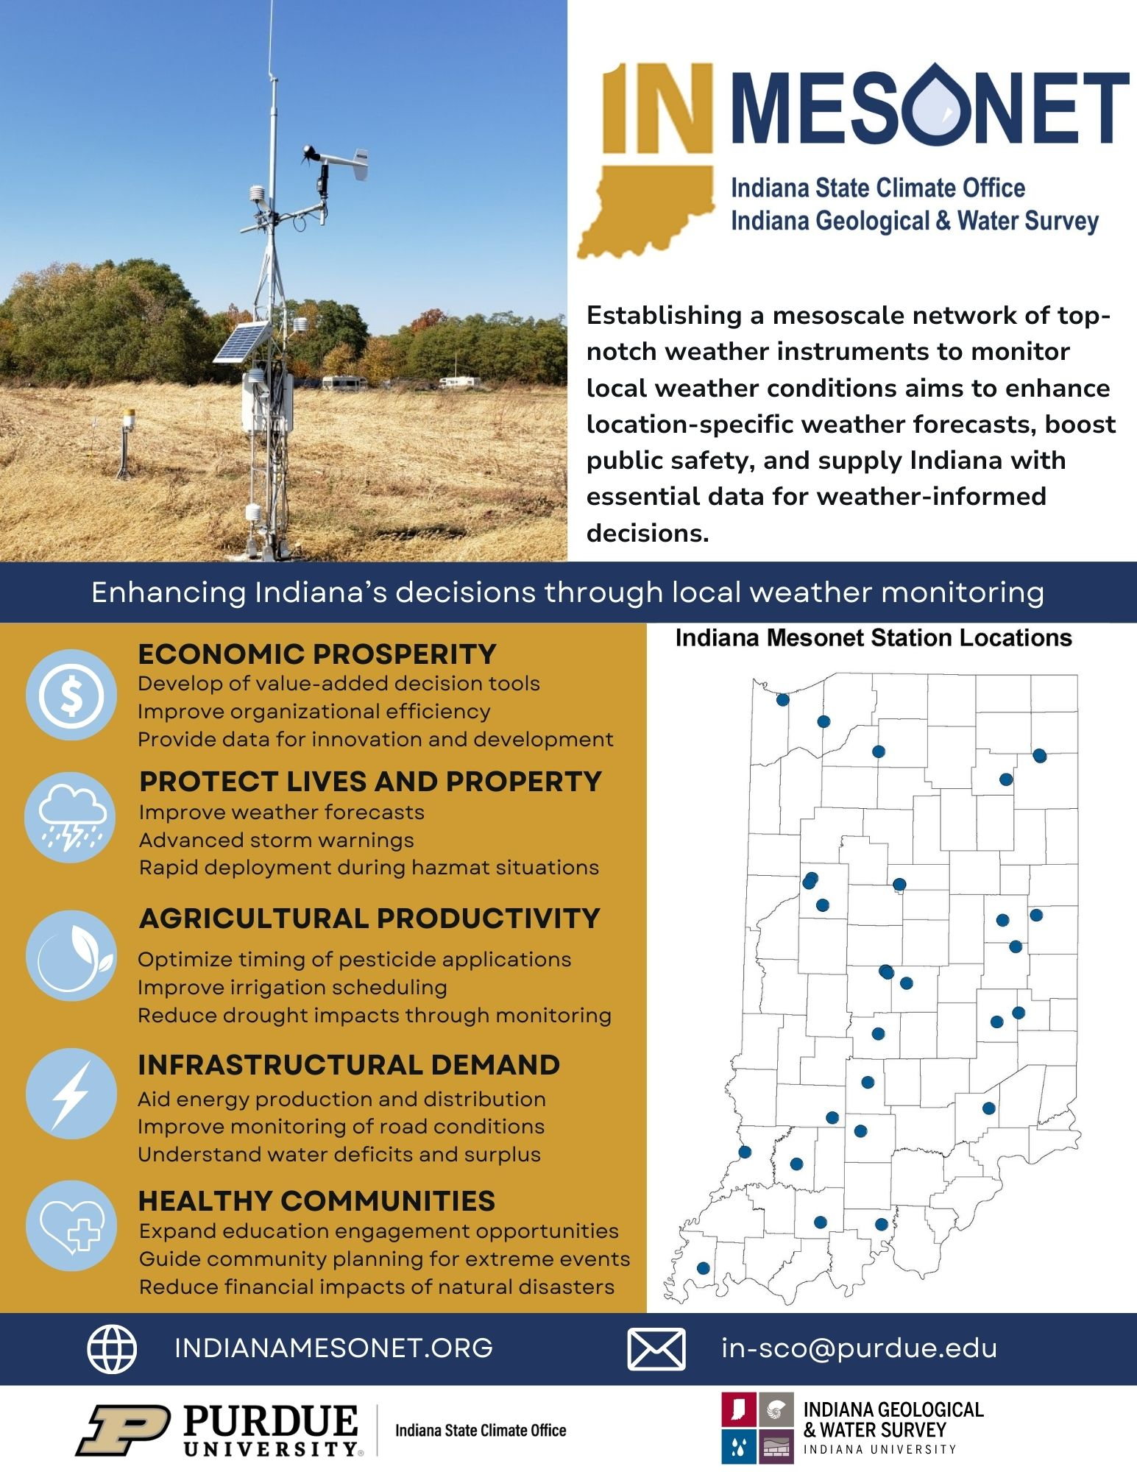
Formation of Indiana Mesonet & IMAB
Complimentary networks; Remove redundancy; Leverage each other’s resources
IMAB members
  Federal
    USGS
    NWS
    USDA-NRCS
  State
    IN-DNR
    ISDA
    IDHS
    IDEM
  Agriculture
    Keystone Coop (Co-Alliance)
    Nutrient Alliance
    IN Farm Bureau (???)
  Energy
    MISO Group
  Other
    INTERA
    Retired Community Engager

Slide 19
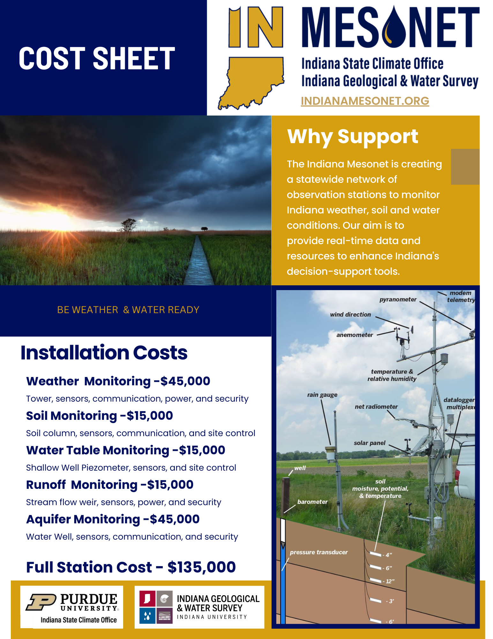
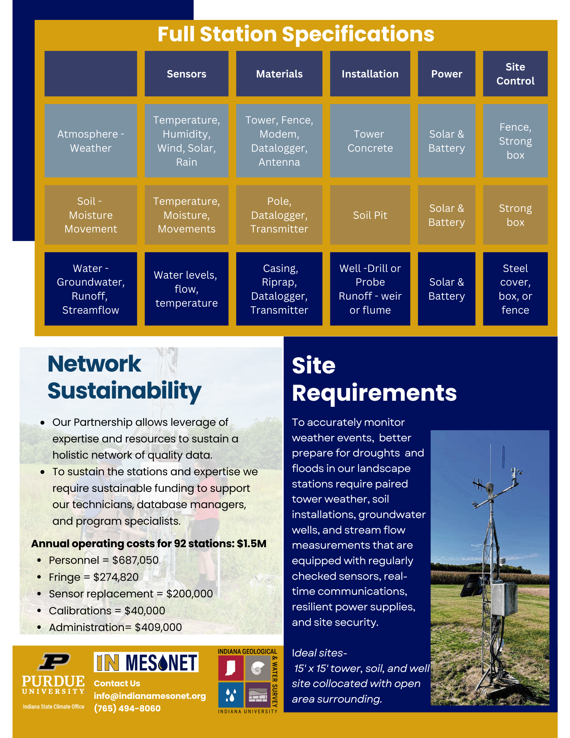
Feedback?

Slide 20

Goals
Expand network
  At least 1 station per county
  Prioritize agricultural, natural areas
  Fill in spatial gaps
Identify communities in need
Continue adding value
  Develop climatologies, perspectives
  Continue development of Indiana Mesonet website
  Integrate forecasts
  Integrate alert system
Integrate new tools and standards
  Snow monitoring
  Cameras
  10-m towers

Slide 21


How can we make the
Indiana Mesonet vision happen?
Beth Hall
bethhall@purdue.edu
Ginger Davis
gindavis@iu.edu
June 2024

