Slide 1
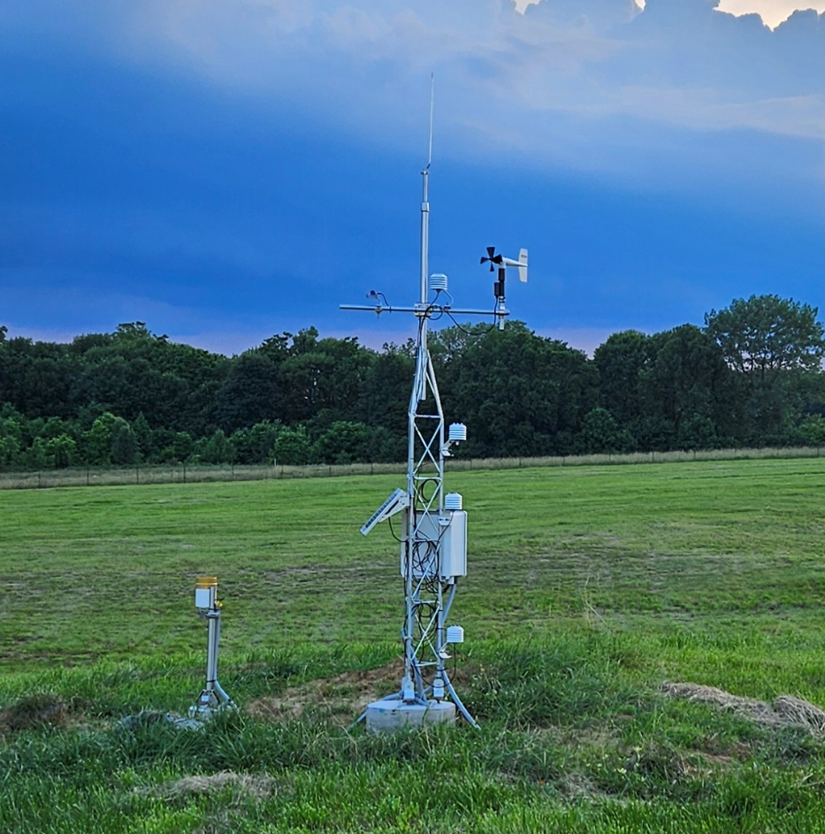
About the Indiana Mesonet
<Presenter Name>
<Title>
<Organization>
<Date>

Slide 2
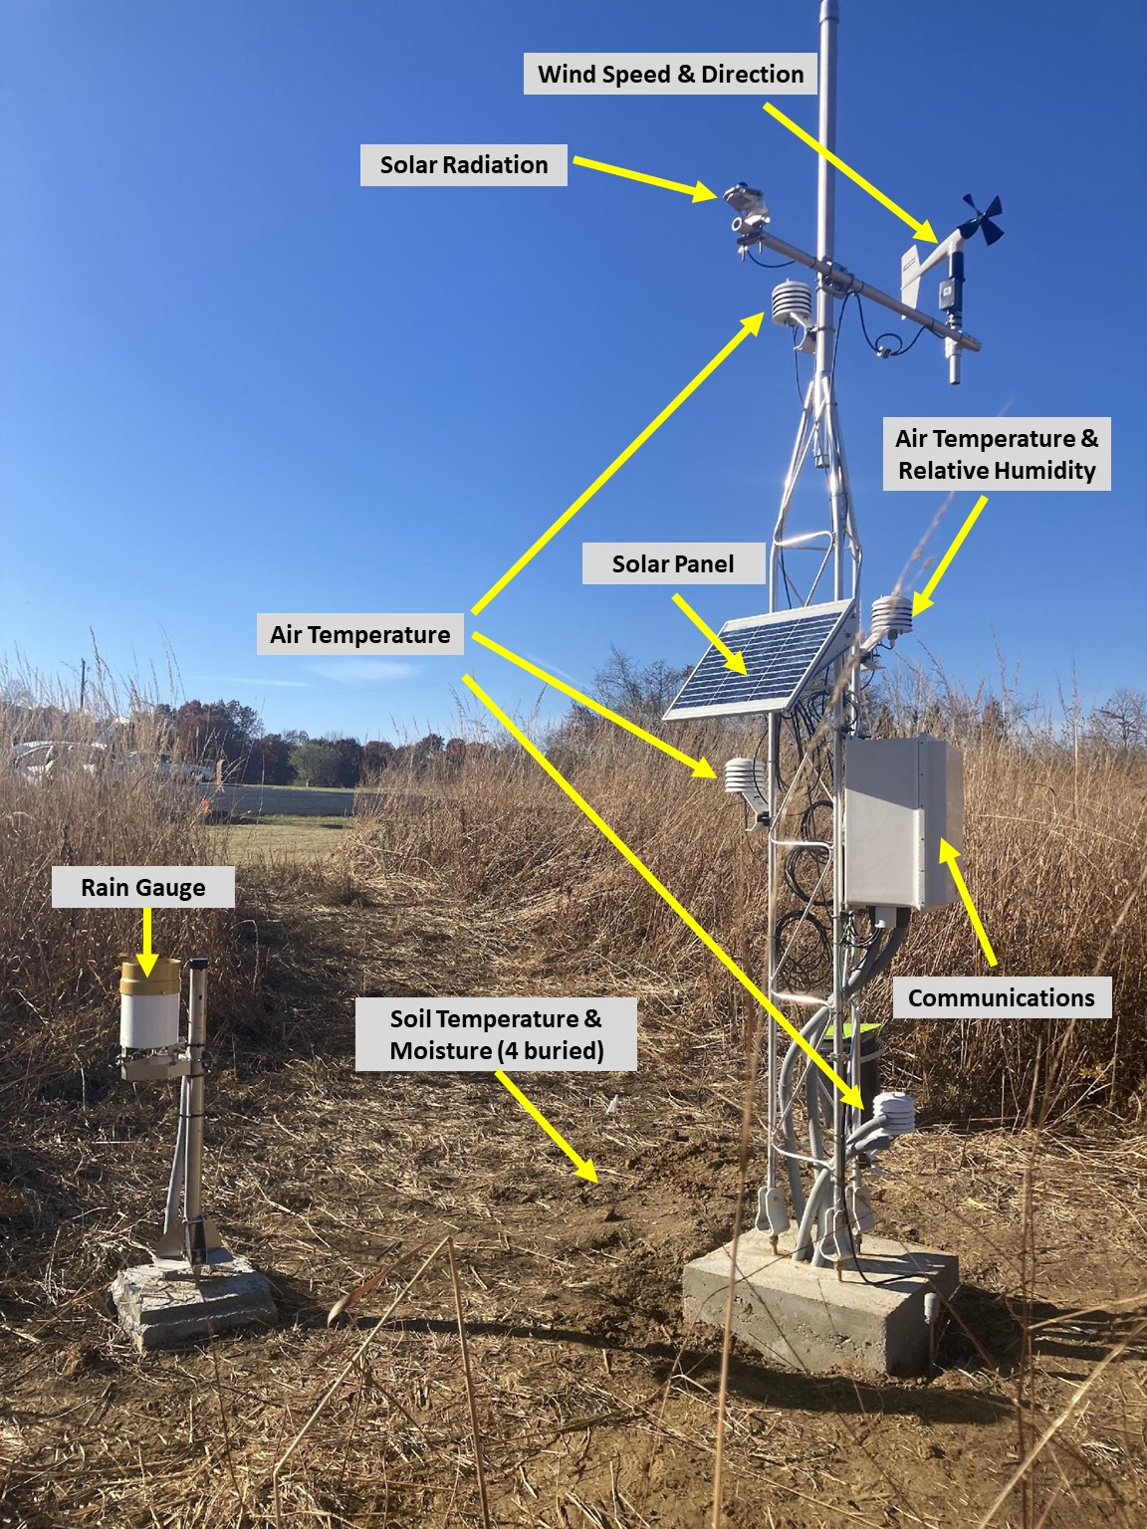
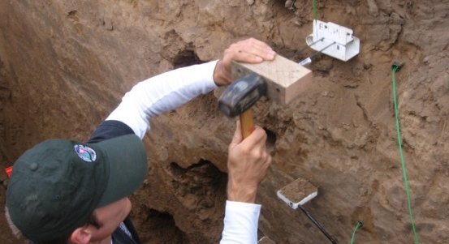
What is a Mesonet?
Mesonet
A spatially-dense network of environmental monitoring infrastructure that provides high-quality, frequent weather, long-term water, and soil observations.
Ideally, one or more stations per county.

Slide 3
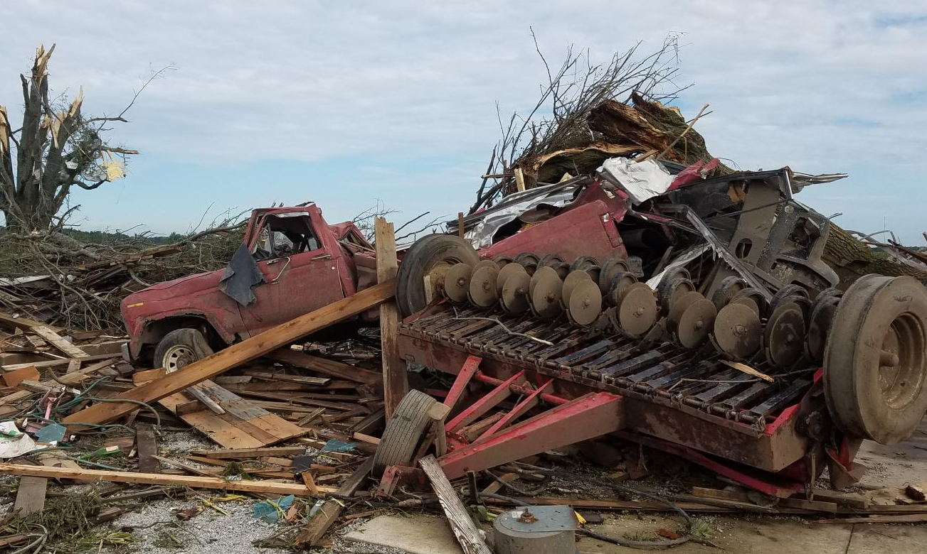
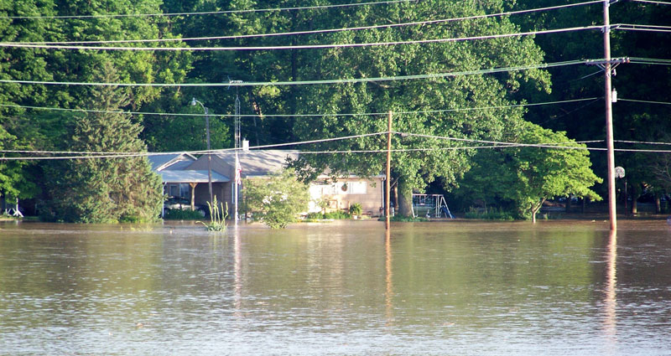
Highlighting the Need
Weather conditions change rapidly over short temporal and spatial scales, which are best detected by at least one monitoring station per county.
Hazardous events can increase vulnerability due to profound impacts on transportation, businesses, and personal safety.
Deliver more frequent and localized environmental information to weather forecasters, emergency responders, and communities, empowering them to make informed decisions.
Woodburn, IN – August 2016
Elnora, IN – June 2008

Slide 4
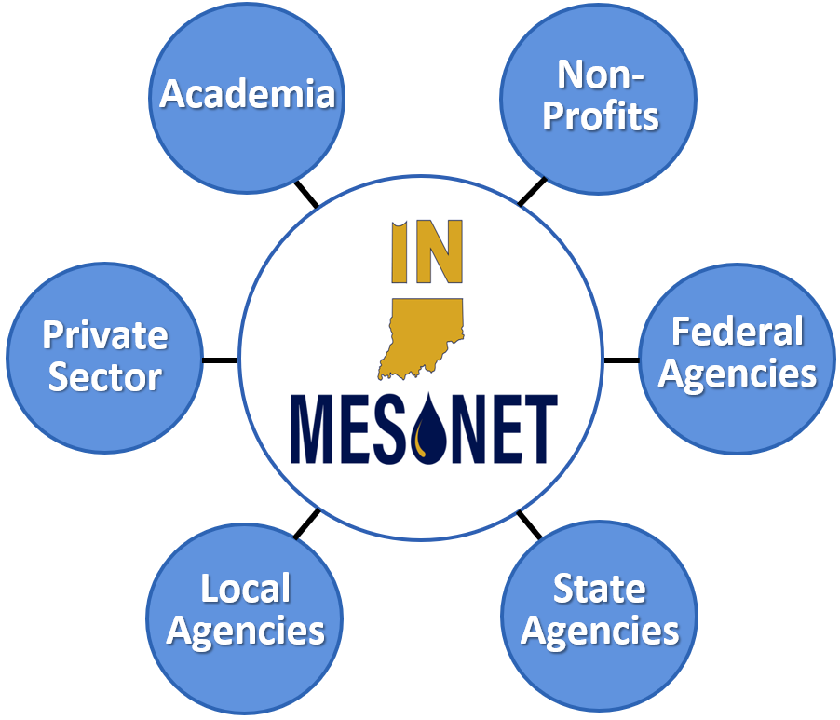
The Indiana Mesonet
Mission
Collect and deliver reliable, high-quality, local weather, water, and soil information across Indiana to be used for the public good.
Vision
An accessible weather, water, and soil observational network across Indiana serving all communities, to enhance public safety, improve economic and resource management, and meet evolving needs.

Slide 5
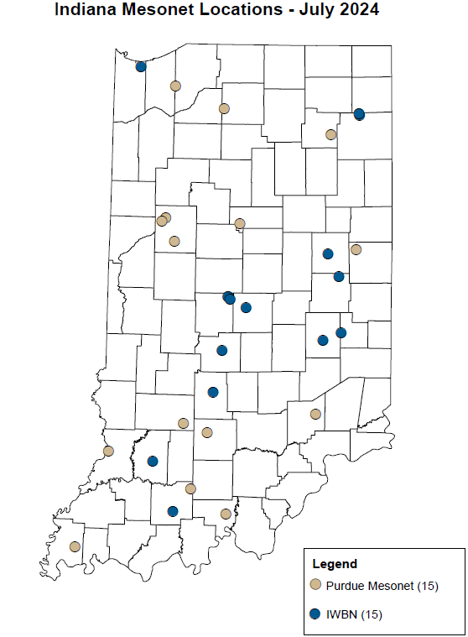
The Current Mesonet
Comprises two networks:
Purdue Mesonet – managed by the Indiana State Climate Office
Indiana Water Balance Network – managed by the Indiana Geological & Water Survey
Reflects only about a quarter of Indiana’s 92 counties.
Limited funding currently impedes the maintenance and expansion of the Indiana Mesonet and its partnerships.

Slide 6
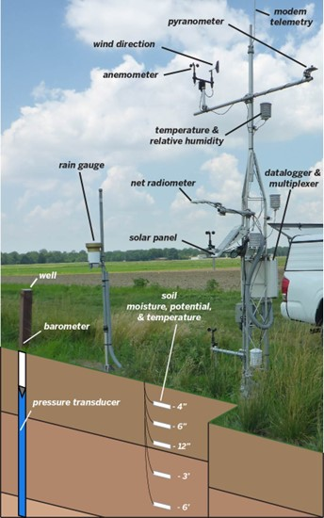
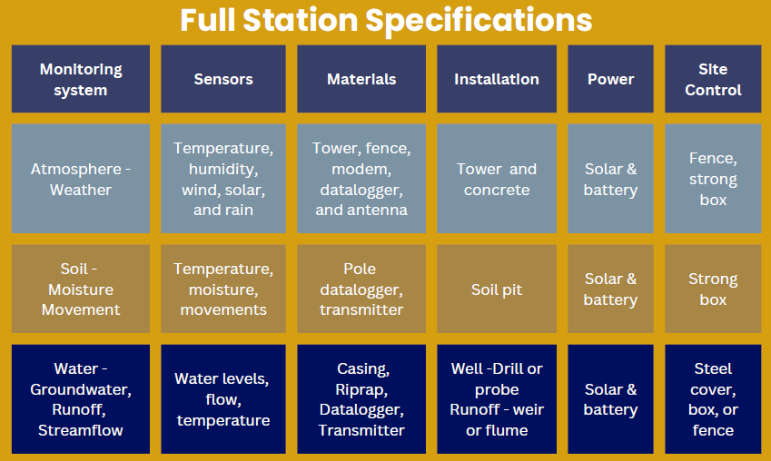
Station Specifications

Slide 7

Expanding the Network
Sustainable funding:
To maintain and expand the Indiana Mesonet.
To ensure reliable access to high-quality environmental monitoring and decision support tools
To serve multiple agencies
Across ALL Indiana counties.
Our partnership allows leverage of expertise and resources to sustain a holistic network of quality data.
Help support technicians, database managers, and program specialists.

Slide 8
Costs
Installation Costs per station - $135,000
Weather Monitoring - $45,000
Tower, sensors, communication, power, and security
Soil Monitoring - $15,000
Soil column, sensors, communication, power, and site control
Water Table Monitoring - $15,000
Stream flow, sensors, power, and security
Runoff Monitoring - $15,000
Water well, sensors, communication, and security
Aquifer Monitoring - $45,000
68 more stations to cover one per county
Network Sustainability Costs per year - $1.6M
Personnel - $996,000
Sensor Replacement - $200,000
Calibrations - $40,000
Administration - $434,000

Slide 9






Benefits
Mesonets provide ample benefits. Here are a few examples.
ECONOMIC PROSPERITY
Decision tools that add economic value
Support organizational efficiency
Data for innovation, growth, research
INFRASTRUCTURAL DEMAND
Enhance water supply monitoring
Aid energy production and distribution
Improve knowledge of road conditions
WEATHER HAZARDS & IMPACTS
Facilitate protection of life and property
Dense data for forecasts, climate record
Better analysis of precipitation extremes
COMMUNITY INVOLVEMENT
Expand education and research
Guide community planning for extremes
Perform impact analysis after disasters
AGRICULTURAL PRODUCTIVITY
Optimize pesticide application timing
Improve irrigation scheduling
Aid crop and livestock health monitoring
PUBLIC HEALTH
Facilitate protection from heat illnesses
Aid hazmat planning and response
Assist food and water security decisions

Slide 10
How Can You Help?
Advocate for the expansion of the Indiana Mesonet to enhance environmental monitoring by spreading the word about the benefits of a mesonet.
Become a site host for a mesonet station, which will contribute directly to data collection and improve the accuracy of weather predictions and environmental monitoring in your area.
Site Host Requirements
10 ft x 10 ft area for station and possible fencing enclosure
60 ft x 60 ft open area where station is located at least two times the distance from the height of the tallest obstruction
Location that is environmentally representative of broader area

Slide 11
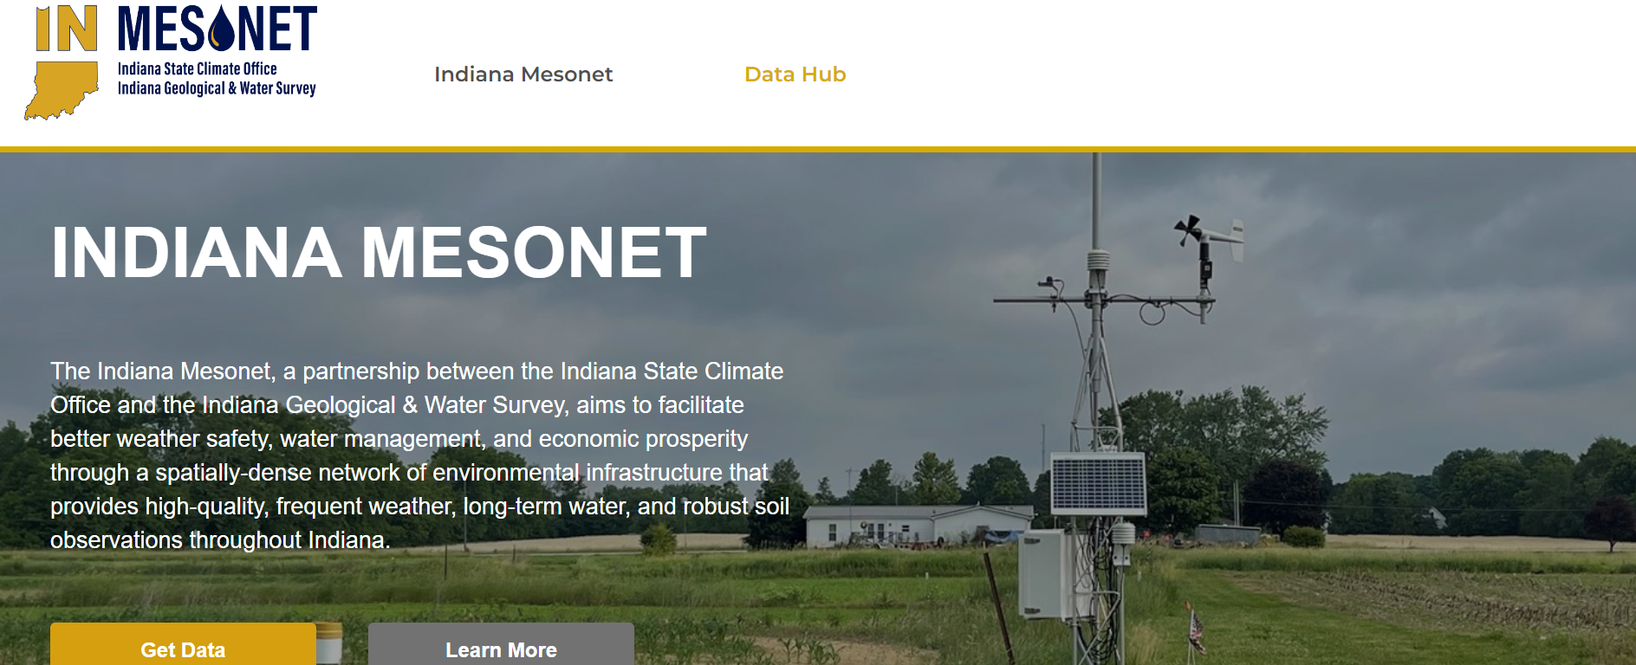
Website Coming Soon
UNDER CONSTRUCTION

Slide 12



Contact Us
indianamesonet.org
info@indianamesonet.org
765-494-8060

