Slide 1
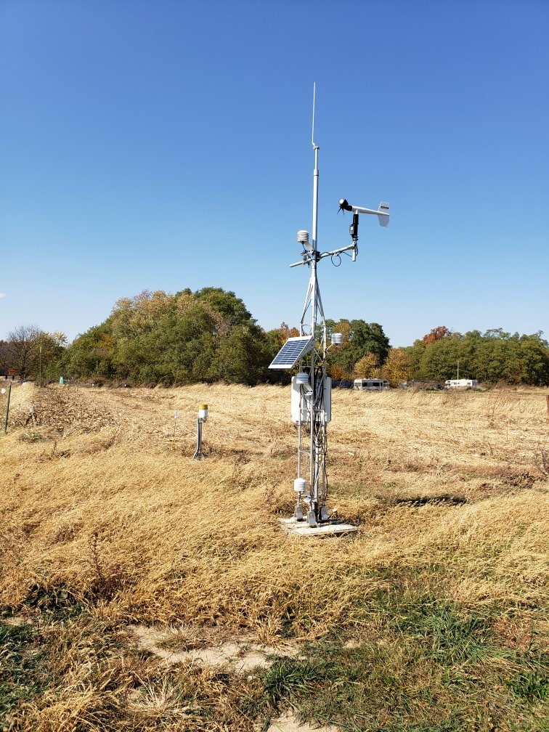
Purdue Mesonet
Update to IMAB
November 2024

Slide 2
Outreach efforts – since last meeting
Scientech – Oct 7th
  Several volunteered to talk to others
EMAI – Oct 17th
  Stephanie McKinney – Gibson Co
  John Summerlot – IU
  Matt True – Jefferson Co
Vermillion County SWCD – Oct 21st
  Doug Martin – town of Universal
  Amanda Heber – I-74 corridor
  Jeff Michalic – RISE facility
Riverscape (Vigo Co / Terre Haute) – Oct 23rd (Jane Santucci)
  Michelle Payne and Wayne Dennison

Slide 3
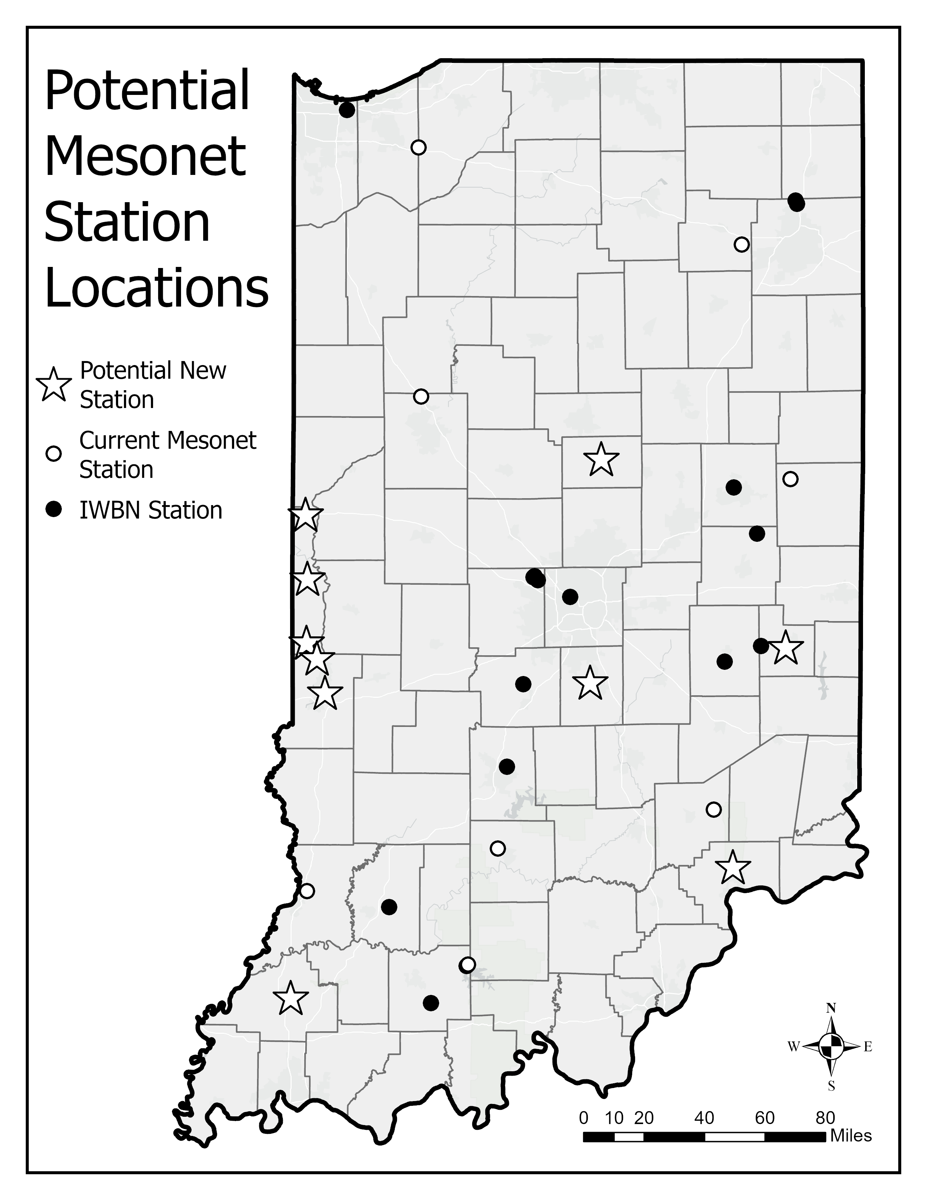
Potential new sites
Vermillion Co – Amanda Heber (I-74 corridor)
Vermillion Co – Jeff Michalic (RISE facility)
Tipton Co – Gregg Burch; Tipton Golf Course
Vermillion Co – Doug Martin; Universal (SWCD); ~3 potential locations (e.g., private farms, RISE facility) – Oct 21?
Wayne Co – Michael Hoff; Whitewater Valley Land Trust
Fayette Co – Wade Walling (EMA); Animal shelter grounds; BRIC grant
Vermillion Co – Jackie Martin; Family farm at Vermillion / Vigo border
Johnson Co – Jerry Spindler (Endress & Hauser); on E&H campus
Vigo Co – Michelle Payne & Wayne Dennison; Rose-Hulman U.
Jefferson Co – Matt True
Gibson Co – Stephanie McKinney; EMA

Slide 4
Indiana Mesonet– expansion plan
Pilot projects:
ID a Purdue site and add on hydro monitoring
ID an IWBN site and have IN-SCO adopt full suite
Issues of consideration:
Infrastructure – is current set up enough?
  Power supply (solar panels; battery)
  Data plan
  Datalogger
Personnel
  IT (database, website interface)
  Technician

Slide 5
Funding efforts – University bridge funding
Value of Mesonet to Purdue University
Purdue researchers utilize mesonet data
  Graduate students (e.g., phenotyping)
  Field trials (e.g., Extension specialists)
  Operational resources (e.g., Turfgrass tool, Tarspot tool)
  Irrigation scheduling and research
Facilitates broad partnerships and dependencies across state
  External advisory board
  Demonstration of Purdue’s commitment to service and collaboration
Marketing and promotion of Purdue’s service to state
  Near real-time weather monitoring across state
  Local media (e.g., television, radio, newspapers, circulars)
  Broad outreach efforts via the IN-SCO
  Diverse stakeholder usage of online tools and resources
Data resource for research grants and contracts
  Online decision-support tools
  NWS / USDA tools and climatologies
  IN corn/soy interests

Slide 6
Funding efforts – University bridge funding
Value of Mesonet to Purdue University
Specialized condition monitoring
  Low-level inversions (e.g., chemical applications and drift)
  Soil temperature and moisture at multiple depths (e.g., state drought taskforce)
More stations translate to
  More revenue from NMP
  Increased awareness of Purdue within local communities
  More value for research and future funding

Slide 7
Funding efforts – University bridge funding
Financial Need for current program with IWBN expansion
 | Item | Quantity | Description | Monthly | Annual
Personnel | Site technicians | 1 FTE per 15 stations | Minimum 3 site visits / yr / station Trouble shoot issues Instrument calibration and testing Vender interactions Manual QA/QC Potential site location assessments | $5,950 | $71,400
 | Computer specialist | 1 FTE | Database management Full stack developer Applications developer | $8,750 | $105,000
 | Climatologist / Assist Operations Manager | 0.25 FTE | Scientific support Outreach / communications | $2,538 | $30,450
 | Site Host | 0.25 FTE | Coordinate contracts, site visits, recognition, etc. | $1,604 | $19,250
Travel | Site visits | 3x/yr Avg 150 miles RT | Clean sensors Clean around station Calibrate sensors Submit situation reports | $402 | $4,824
 | Troubleshoot visits | 1x/yr for 33% sites | Respond to QA/QC issues Log response Correct issues | $42 | $503
 | In-state outreach, speaking engagements | 5x/yr Avg 150 miles RT 1 person attend | Invited speaker engagements | $42 | $503
 | In-person external advisory board meetings | 4x/yr Avg 120 miles RT 2 people attend | Updates on network Funding strategies Marketing strategies | $54 | $643
 | Out-of-state meetings | 1x/yr 2-night hotel transportation 2 people attend | National and regional meetings with other state mesonets, national sponsors, vendors, etc. | $295 | $3,536
TOTAL: |  |  |  | $19,677.00 | $236,109.00

Slide 8
Outreach efforts - upcoming
Kentuckiana Crops Event – December
Tri-State County Crop Advisors (CCA) Conference – December
Indiana Soil Water Conservation Districts annual Meeting -- January

Slide 9
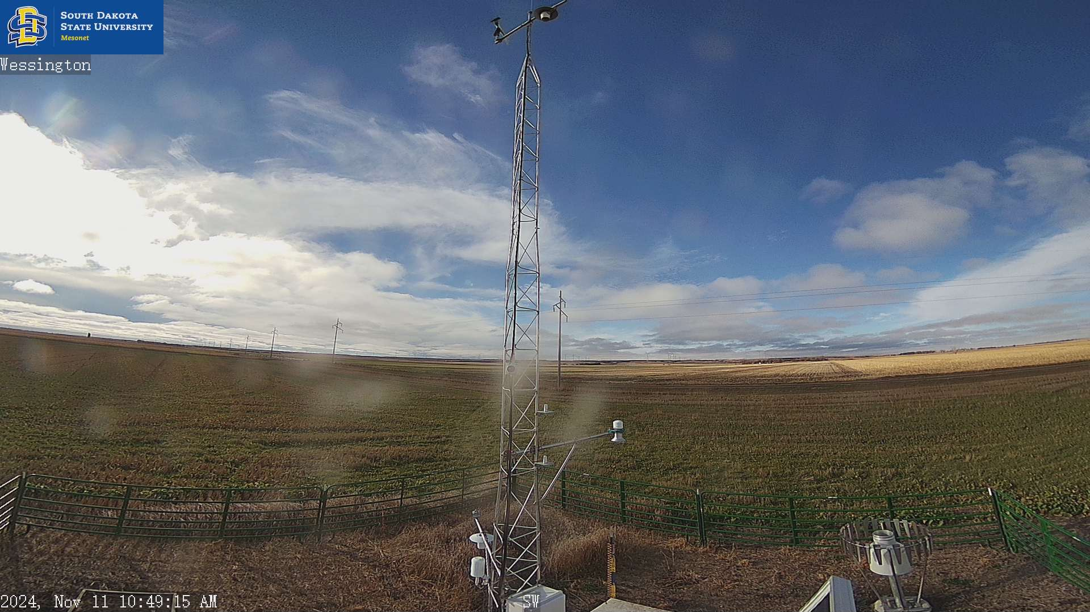
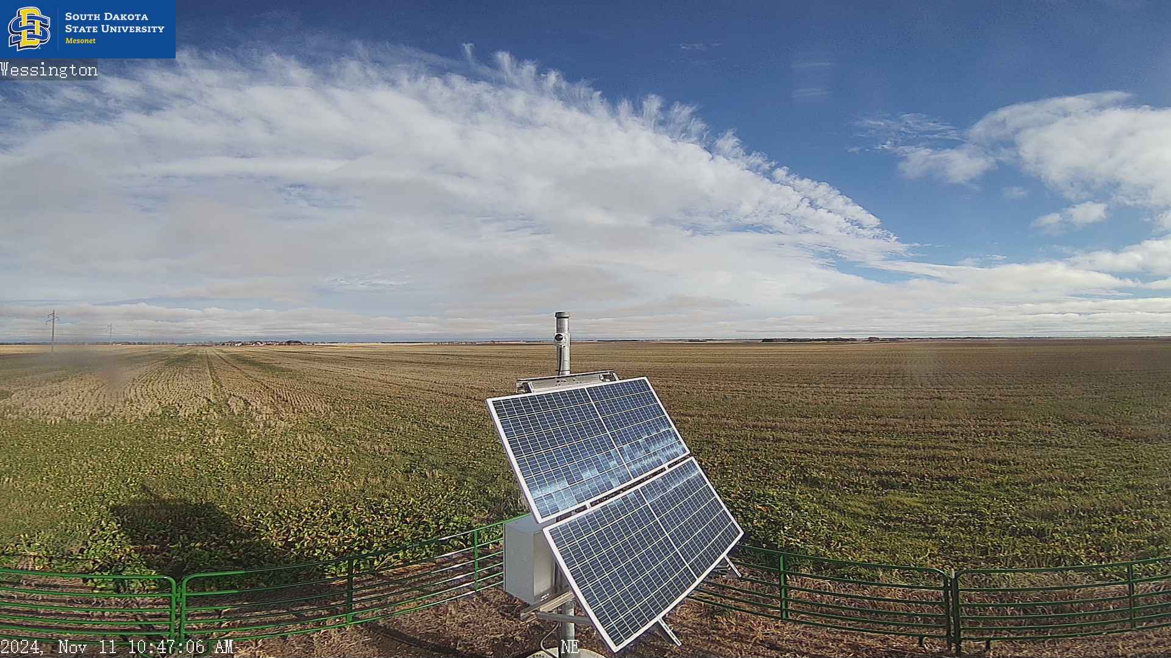
Sensor exploration
Snow depth sensors
Barometers
Weighed rain gauges
Cameras

Slide 10
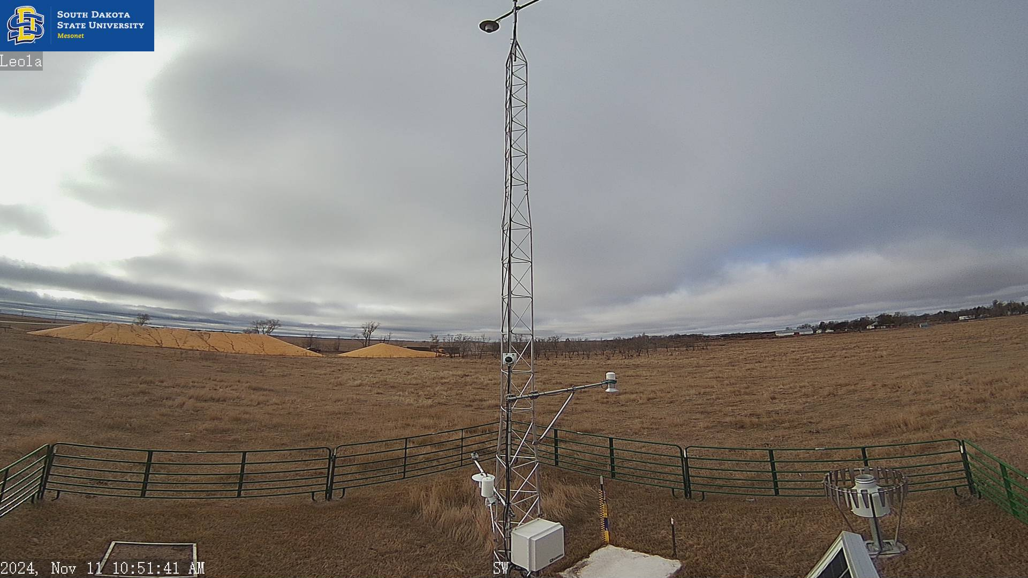
Sensor exploration
Training with the SD Mesonet – this week!

Slide 11
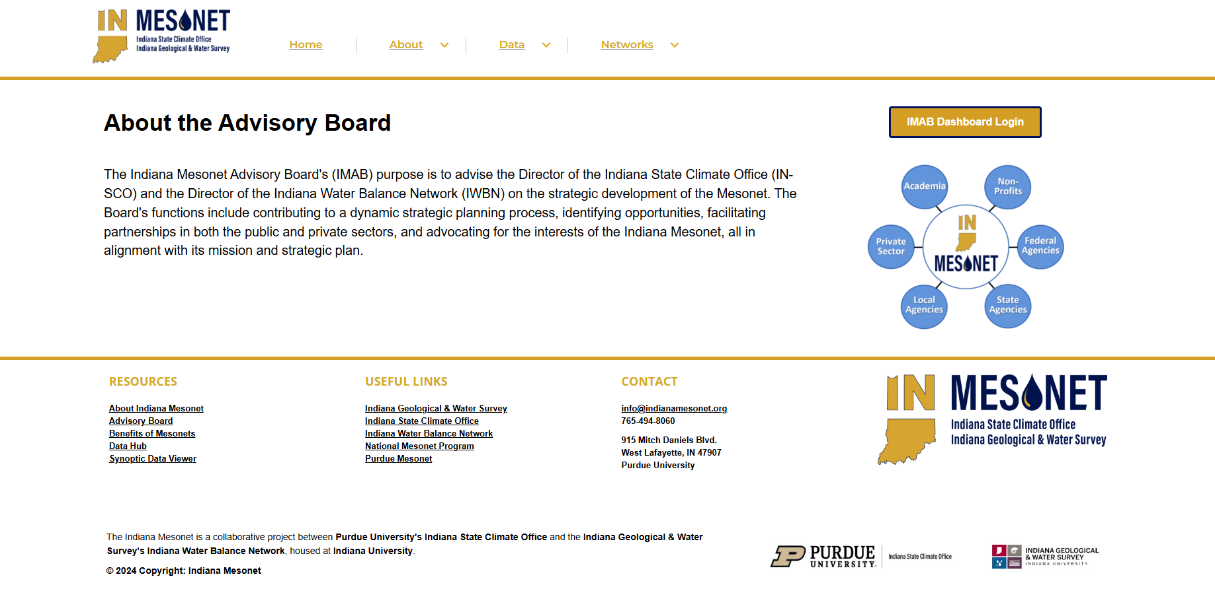
Indiana Mesonet website
Austin Show & Tell

Slide 12

Indiana Mesonet website
Austin Show & Tell
Password:
2024Members

Slide 13
Indiana Mesonet website
Austin Live Demo

