Slide 1
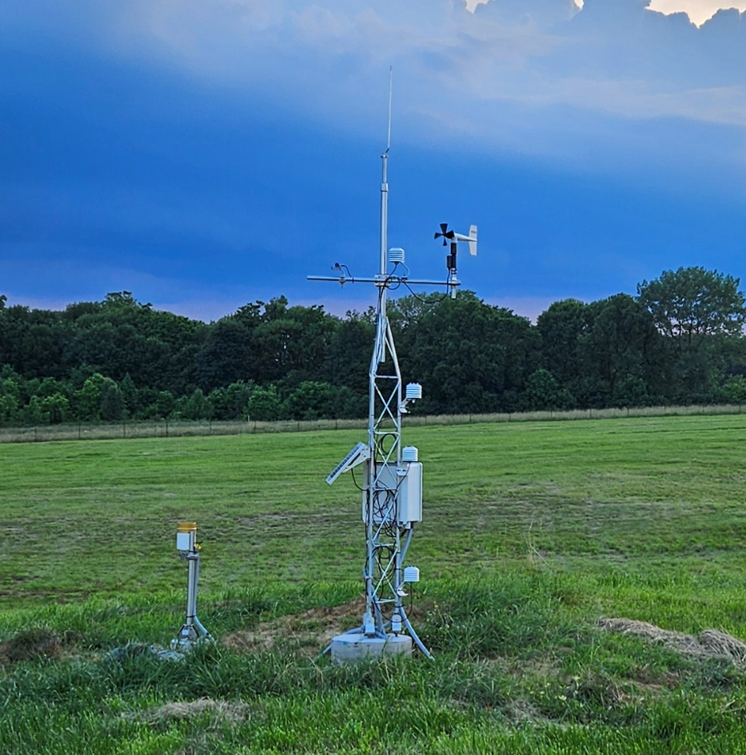
About the
Indiana Mesonet
<Presenter Name>
<Title>
<Organization>
<Date>

Slide 2
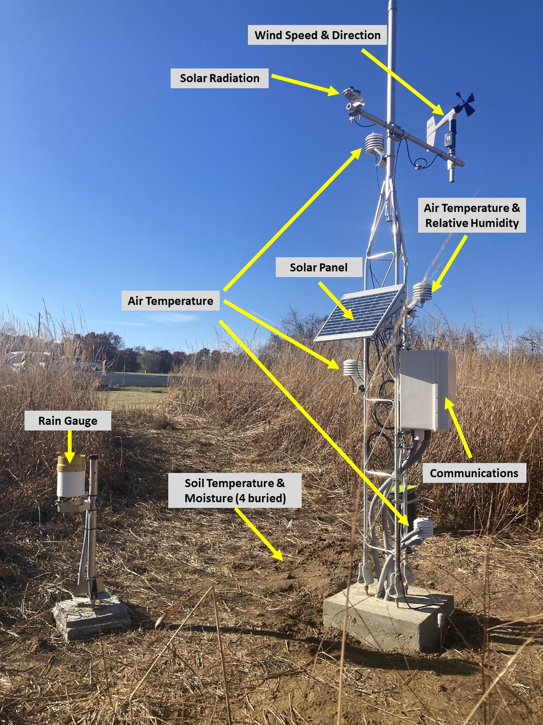
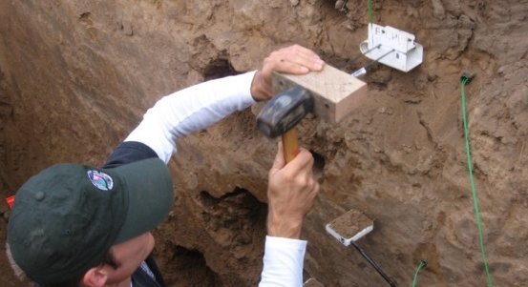
What is a Mesonet?
Mesonet
  A spatially-dense network of environmental monitoring infrastructure that provides high-quality, frequent weather, long-term water, and soil observations.
  Ideally, one or more stations per county.

Slide 3
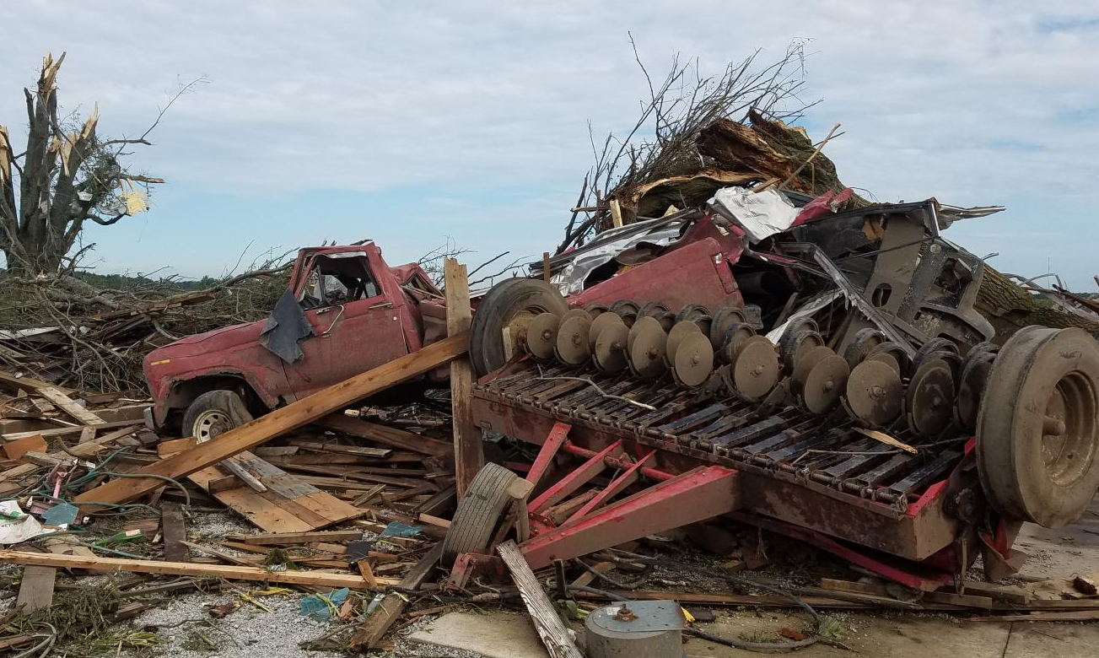
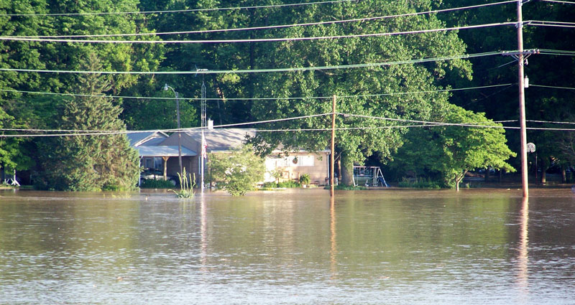
Highlighting the Need
Weather conditions change rapidly over short temporal and spatial scales, which are best detected by at least one monitoring station per county.
Hazardous events can increase vulnerability due to profound impacts on transportation, businesses, and personal safety.
Deliver more frequent and localized environmental information to weather forecasters, emergency responders, and communities, empowering them to make informed decisions.
Woodburn, IN – August 2016
Elnora, IN – June 2008

Slide 4
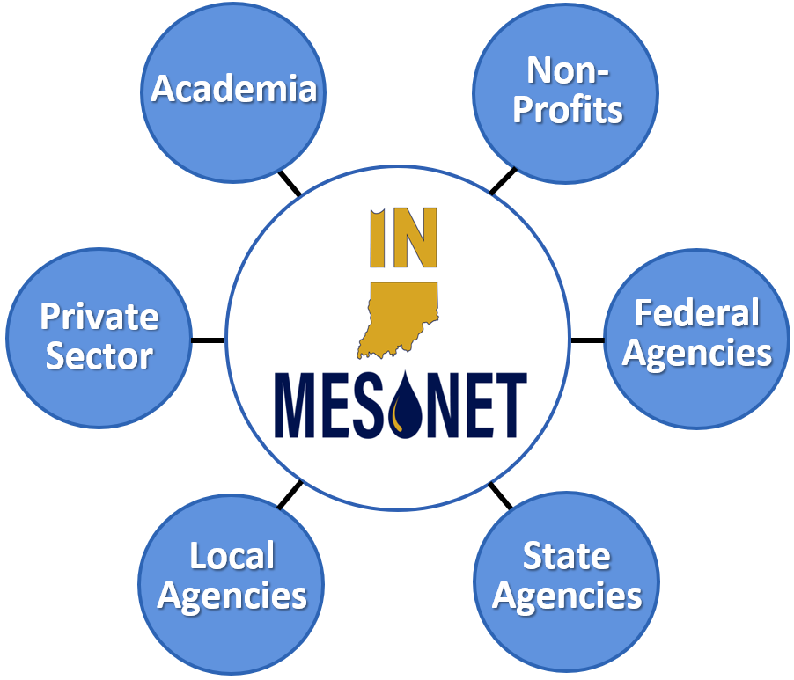
The Indiana Mesonet
Mission
  Collect and deliver reliable, high-quality, local weather, water, and soil information across Indiana to be used for the public good.
Vision
  An accessible weather, water, and soil observational network across Indiana serving all communities, to enhance public safety, improve economic and resource management, and meet evolving needs.

Slide 5
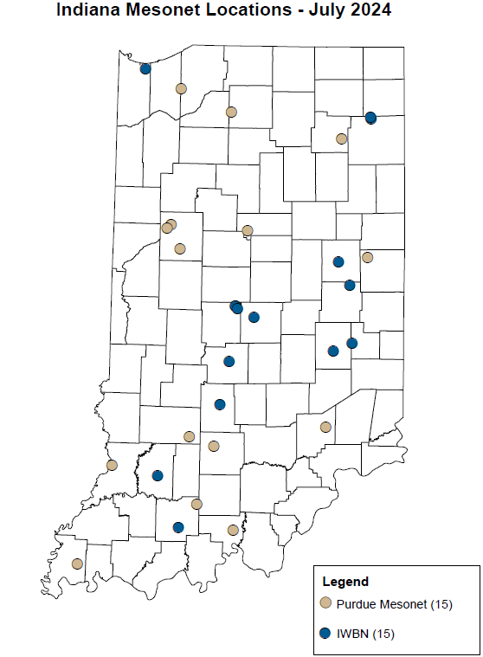
The Current Mesonet
Comprises two networks:
  Purdue Mesonet – managed by the Indiana State Climate Office
  Indiana Water Balance Network – managed by the Indiana Geological & Water Survey
Reflects only about a quarter of Indiana’s 92 counties.
Limited funding currently impedes the maintenance and expansion of the Indiana Mesonet and its partnerships.

Slide 6
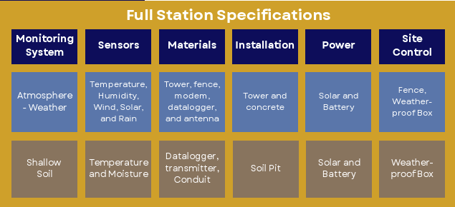
Station Specifications

Slide 7

Expanding the Network
Sustainable funding:
  To maintain and expand the Indiana Mesonet.
  To ensure reliable access to high-quality environmental monitoring and decision support tools
  To serve multiple agencies
  Across ALL Indiana counties.
Our partnership allows leverage of expertise and resources to sustain a holistic network of quality data.
Help support technicians, database managers, and program specialists.

Slide 8
Costs
Installation Costs
Weather Station - $35,000
Personnel - $30,000
Security Fencing (optional) - $5,000
Network Sustainability
To maintain an operational network, sustainable funding is essential. The annual costs to support a network of 92 stations (one per county) total approximately $1.05 million, averaging about $11,400 per station, which includes:
Personnel - $730,000
Sensor Replacement - $150,000
Calibrations - $40,000
Travel - $70,000
General Supplies - $60,000

Slide 9


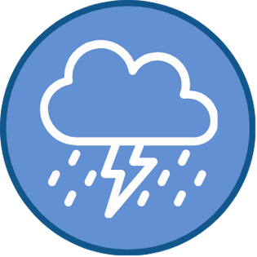



Benefits
Mesonets provide ample benefits. Here are a few examples.
ECONOMIC PROSPERITY
Decision tools that add economic value
Support organizational efficiency
Data for innovation, growth, research
INFRASTRUCTURAL DEMAND
Enhance water supply monitoring
Aid energy production and distribution
Improve knowledge of road conditions
WEATHER HAZARDS & IMPACTS
Facilitate protection of life and property
Dense data for forecasts, climate record
Better analysis of precipitation extremes
COMMUNITY INVOLVEMENT
Expand education and research
Guide community planning for extremes
Perform impact analysis after disasters
AGRICULTURAL PRODUCTIVITY
Optimize pesticide application timing
Improve irrigation scheduling
Aid crop and livestock health monitoring
PUBLIC HEALTH
Facilitate protection from heat illnesses
Aid hazmat planning and response
Assist food and water security decisions

Slide 10
How Can You Help?
Advocate for the expansion of the Indiana Mesonet to enhance environmental monitoring by spreading the word about the benefits of a mesonet.
Become a site host for a mesonet station, which will contribute directly to data collection and improve the accuracy of weather predictions and environmental monitoring in your area.
The Ideal Site
Located on relatively flat, open terrain (~1 acre) representative of the surrounding area
Free of obstructions (e.g., bushes, fences, tree rows, or structures) within a distance of at least 10× their height in all directions
No pavement, crops, or tree lines within 100 ft (30 m); ideally in natural vegetation or grass.
Soil should be typical of the area and historically undisturbed
Not situated in a topographic low or high point that may bias temperature or wind
Not near irrigation systems, ponds, or lakes that could affect humidity or soil moisture
Accessible year-round by vehicle

Slide 11
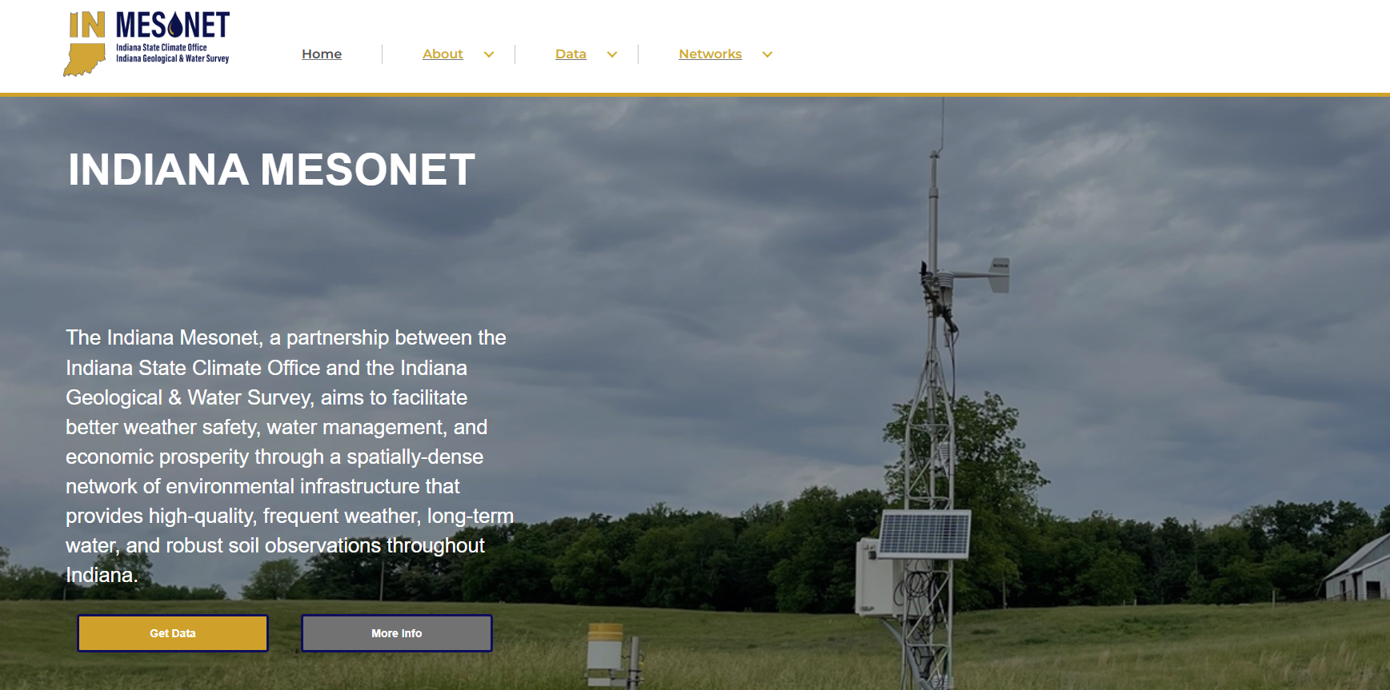
Website

Slide 12



Contact Us
indianamesonet.org
info@indianamesonet.org
765-494-8060

